Slide 1

AI-Drive test automation: RAG systems
December 2024 – Jonathan Espinosa Sr. Data Scientist
Notes:
1

Slide 2
Content
Why EPAM
Introduction:
Basic concepts
RAG components
AI life cycle and testing
Evaluation:
Challenges
Test data generation
Metrics
Workshop
Evaluate RAG application for Q/A
Notes:
2

Slide 3
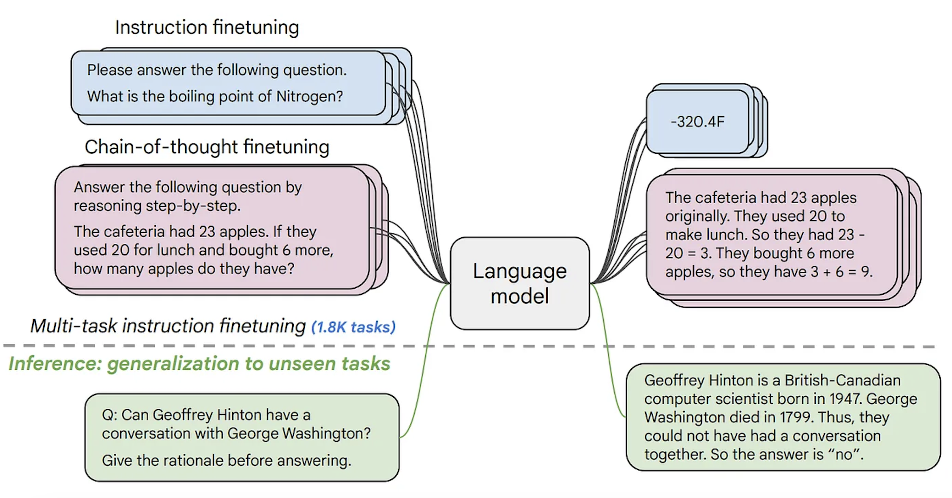
Integrated solutions
LLM
Introduction RAG systems
Notes:
3

Slide 4
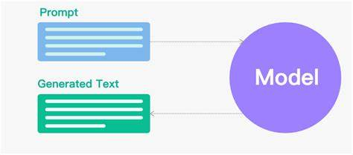
Integrated solutions
Basic uses cases:
Introduction RAG systems
Text generation
Question answering
Text summarization
Text translation
………..
Notes:
4

Slide 5
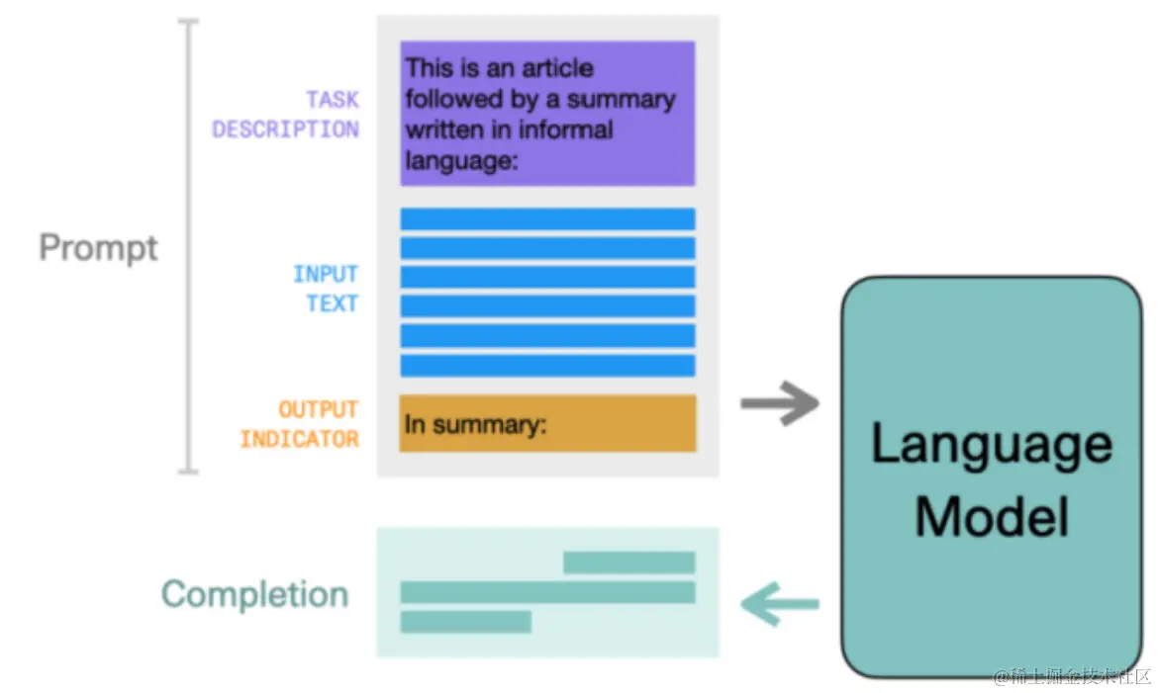
Integrated solutions
Basic prompt structure:
Introduction RAG systems
Notes:
5

Slide 6
RAG systems
Integrated solutions
Challenges of LLM
Prompt: What were the results of the lastest presidential elections in the USA?
Known challenges of LLMs include:
Presenting false information when it does not have the answer.
Presenting out-of-date or generic information when the user expects a specific, current response.
Creating a response from non-authoritative sources.
Creating inaccurate responses due to terminology confusion, wherein different training sources use the same terminology to talk about different things.
Notes:
6

Slide 7
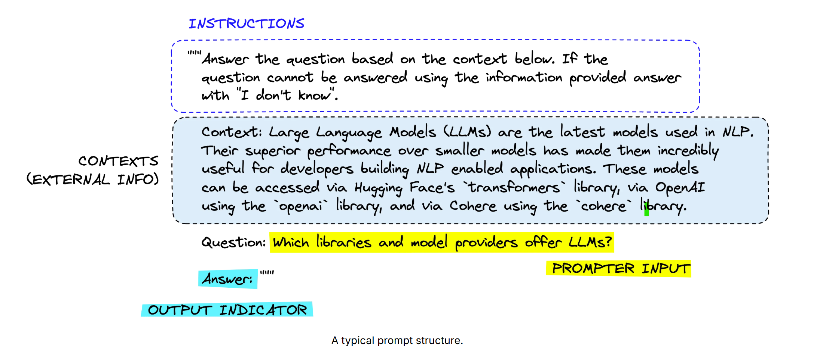
RAG systems
Integrated solutions
RAG advantages
Without RAG, the LLM takes the user input and creates a response based on information it was trained on—or what it already knows. With RAG, an information retrieval component is introduced that utilizes the user input to first pull information from a new data source. The user query and the relevant information are both given to the LLM.
Notes:
7

Slide 8
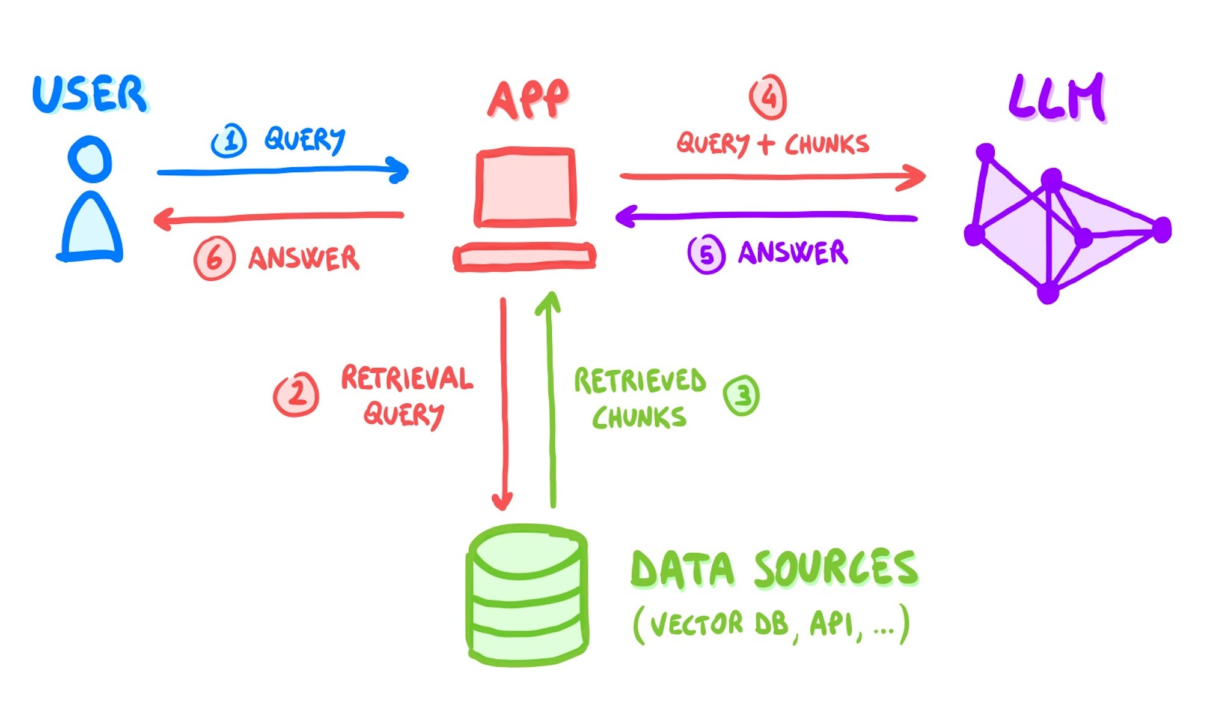
RAG systems
Integrated solutions
RAG Grounding
Grounding is the process of using large language models (LLMs) with information that is use-case specific, relevant, and not available as part of the LLM's trained knowledge.
Notes:
8

Slide 9
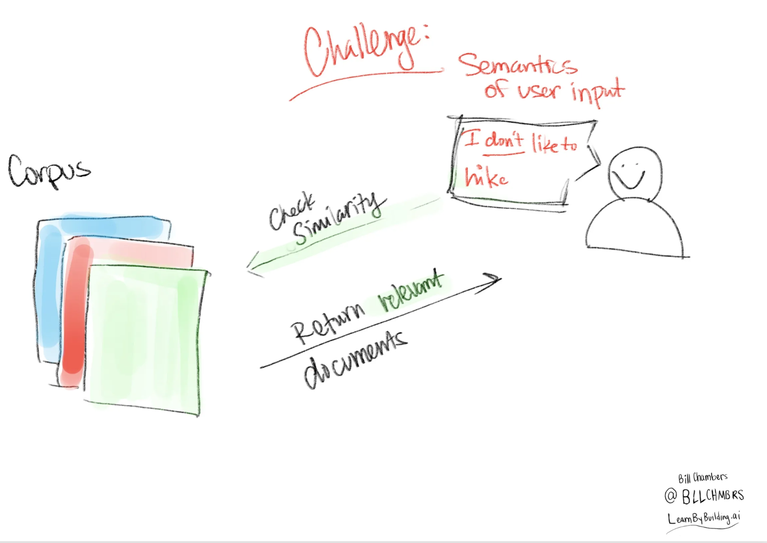
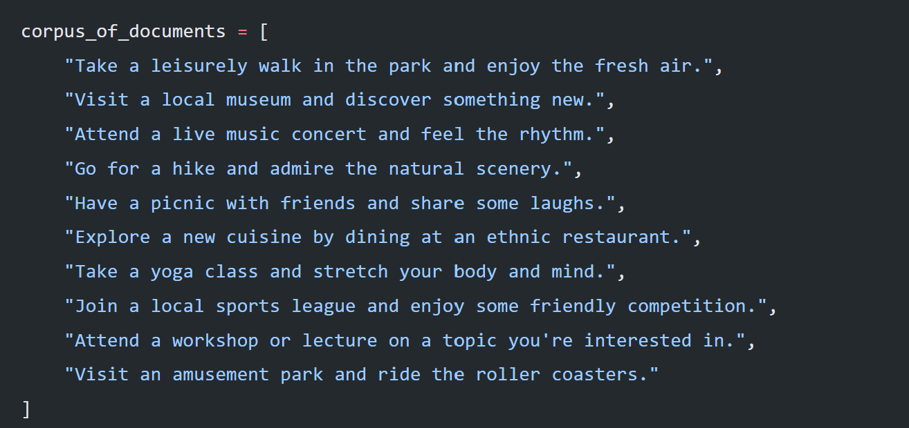
RAG systems
Integrated solutions
Semantic search:
Notes:
9

Slide 10
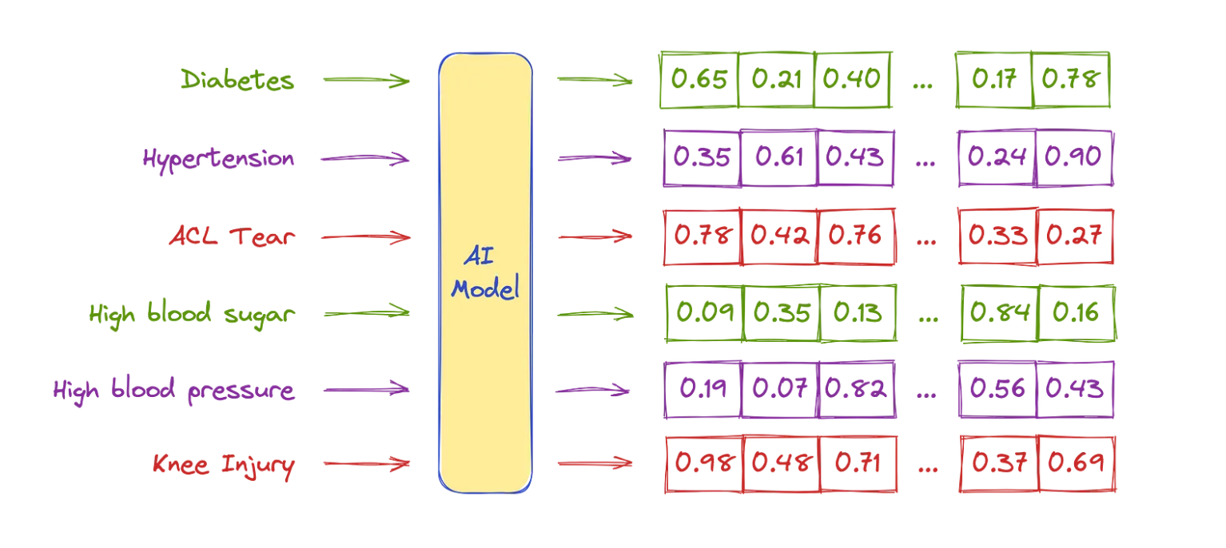
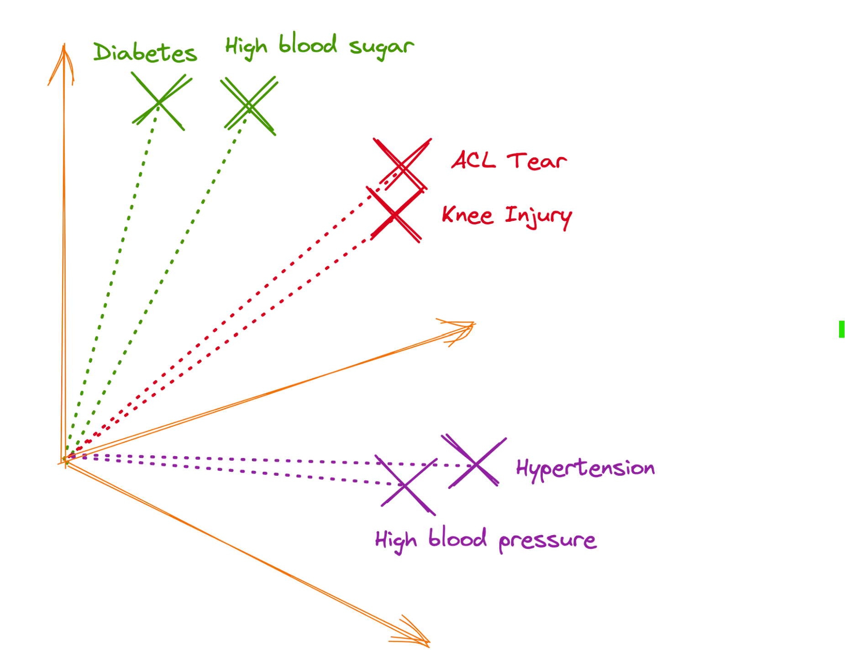
RAG systems
Integrated solutions
Semantic search:
Notes:
10

Slide 11
RAG systems
Integrated solutions
RAG components
Retrieval: This stage entails locating and obtaining pertinent passages of text from an outside knowledge source. Numerous methods, including keyword-based search, semantic similarity search, and neural network-based retrieval, can be used to do this.
Augmentation: After retrieving pertinent snippets, the generation process is enhanced by using them. This can be accomplished in several ways, including by adding more context, boosting the response’s accuracy, or improving its fluency.
Generation: Using the enhanced data, a new answer is produced during this phase. Numerous methods, including template-based generation, statistical language models, and neural network-based generation, can be used to do this.
Notes:
11

Slide 12
RAG systems
Integrated solutions
Models
Embedding models
Generative model
Vector DB
Notes:
12

Slide 13
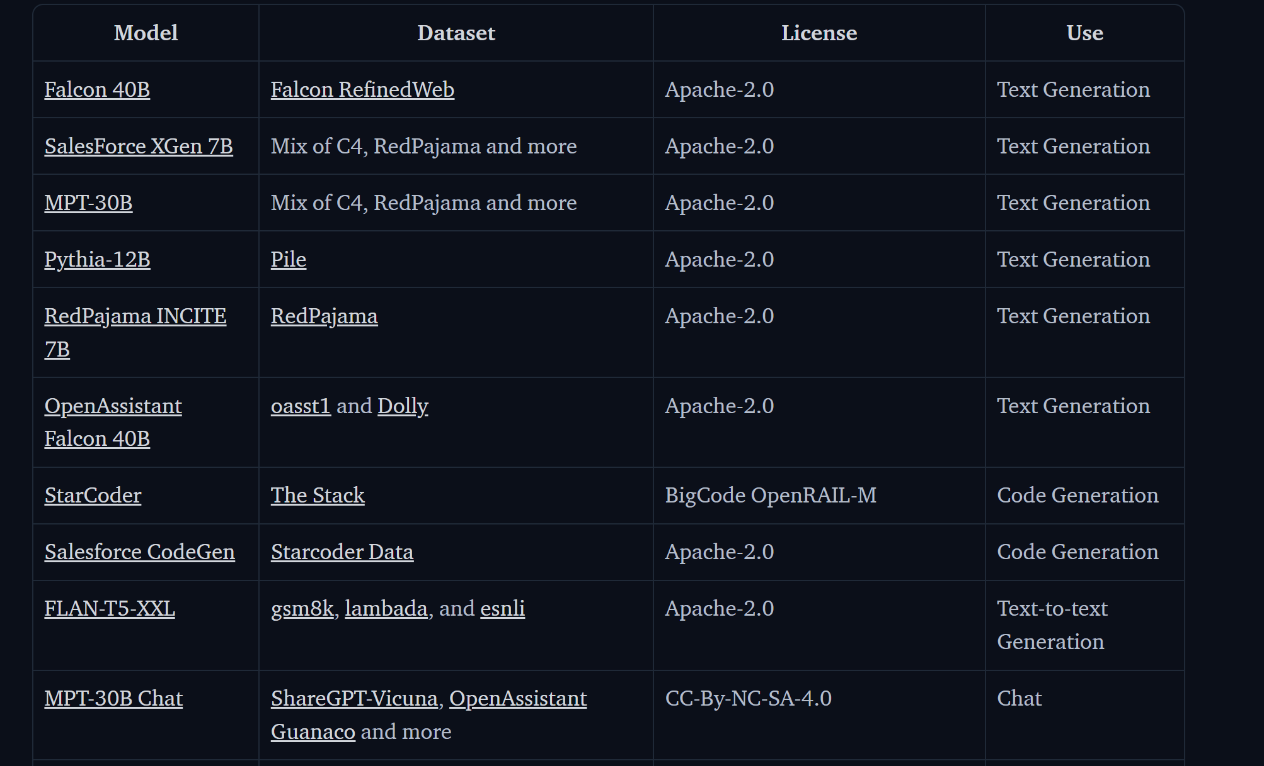
RAG systems
Integrated solutions
Generative model
Main aspects:
Context window size
Latency
Model size
Training data
Uses cases (task)
Performance (benchmark metrics for specific tasks)
……
Notes:
13

Slide 14
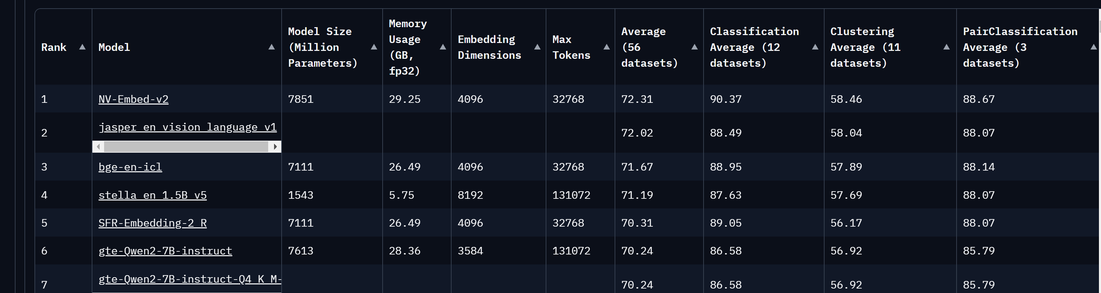
RAG systems
Integrated solutions
Embeddings models
Main Aspects:
…….
Embedding dimensions
……..
Notes:
14

Slide 15
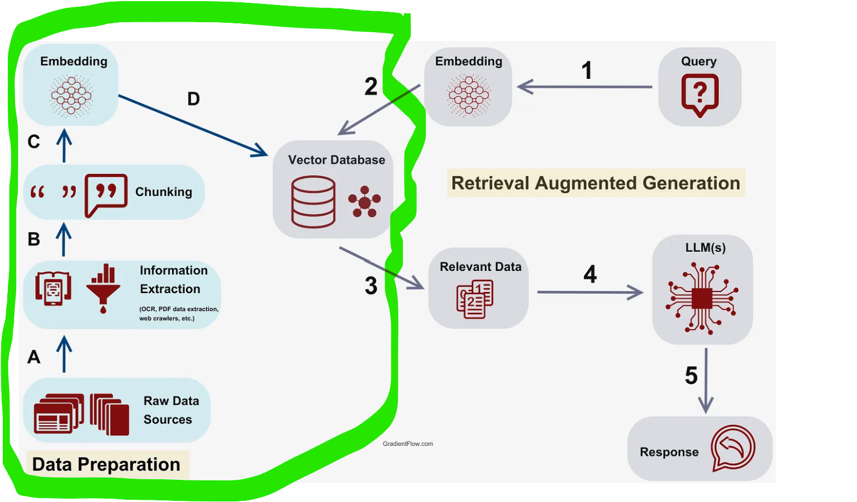
RAG systems
Integrated solutions
Vector DB
Mains aspects:
Vector DB provider
Chunking strategy
Data types
Indexing Algorithms
…..
Notes:
Outsite of scope of lab: but VDB retrieve N most similar chunks
15

Slide 16
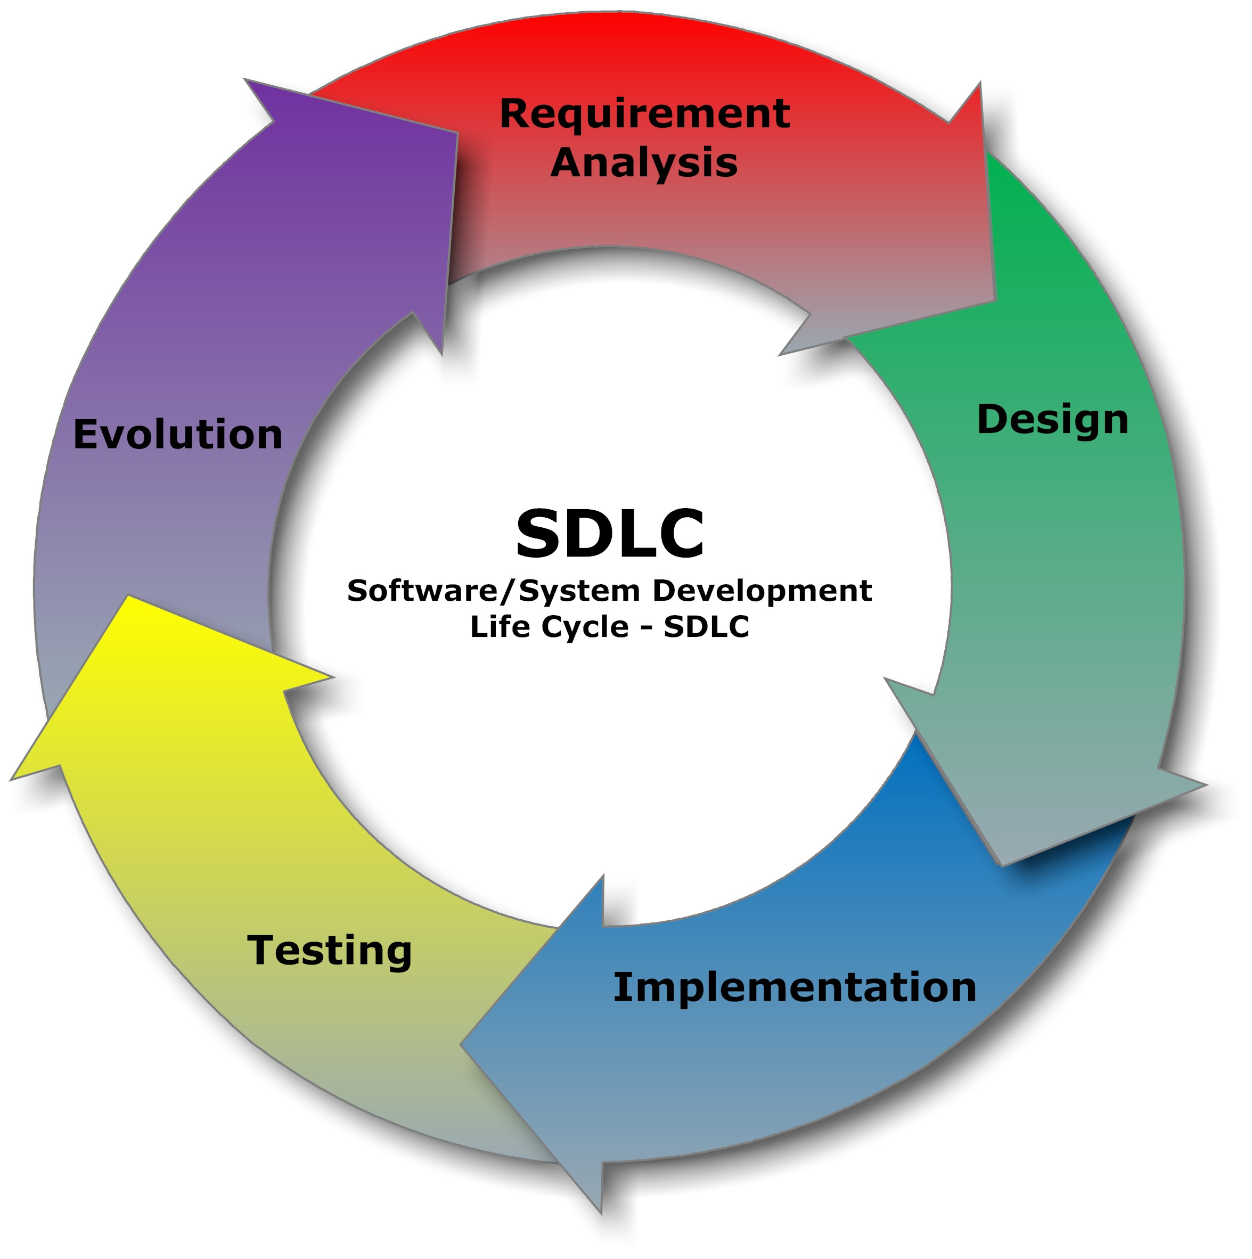
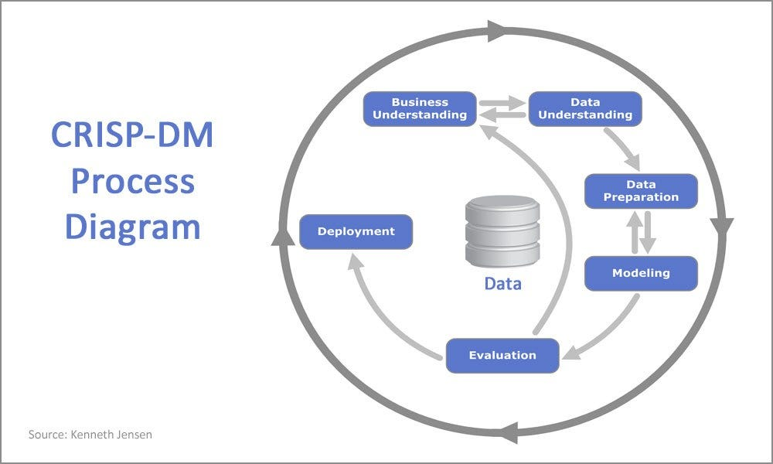
RAG Evaluation
Integrated solutions
SD-LC vs AI-LC
Main Artifacts:
Code
Data
Models
Notes:
16

Slide 17
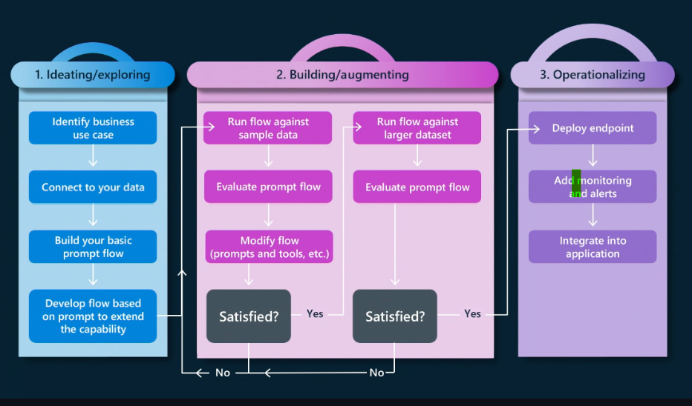
RAG Evaluation
Integrated solutions
LLM Testing
Test types
Unit test
Model and Human evaluation
A/B testing
Notes:
17

Slide 18
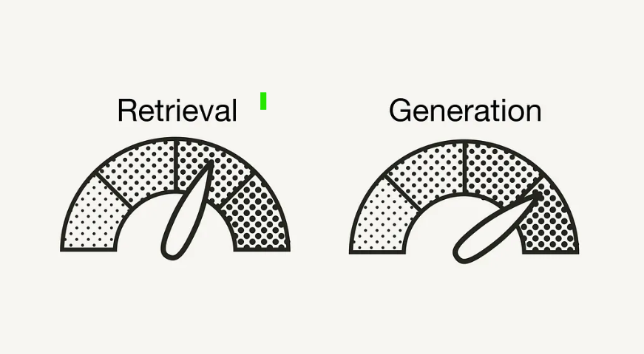
RAG Evaluation
Integrated solutions
Rag evaluation
Retriever component: retrieves additional context from an external database for the LLM to answer the query.
Generator component: generates an answer based on a prompt augmented with the retrieved information
Notes:
18

Slide 19
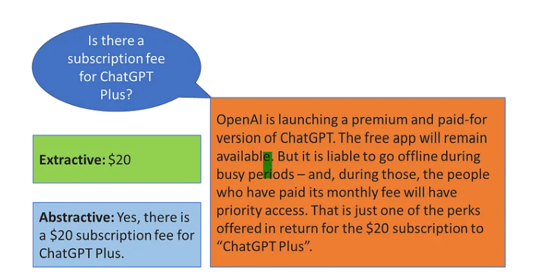
RAG Evaluation
Integrated solutions
QA models: Generative vs Extractive
Extractive QA: The model extracts the answer from a context and provides it directly to the user. It is usually solved with BERT-like models.
Generative QA: The model generates free text directly based on the context. It leverages Text Generation models.
Notes:
19

Slide 20
RAG Evaluation
Integrated solutions
Metrics for retrieval:
Top-N Accuracy (order doesn't matter and ratio is divided over size grand true)
Precision over @k (order doesn't matter and ratio is divided over size @k)
MRR evaluates how well a system places the first relevant result in a ranked
Mean Average Precision (MAP): summary of precision performance cross several @topK ex (top1,top2,top3)/3
Discounted Cumulative Gain (DCG -> (Sum the true scores ranked in the order induced by the predicted scores), (problems when Ideal DCG score is 0)
NDCG considers the relevance of all the results and their positions
Notes:
20

Slide 21
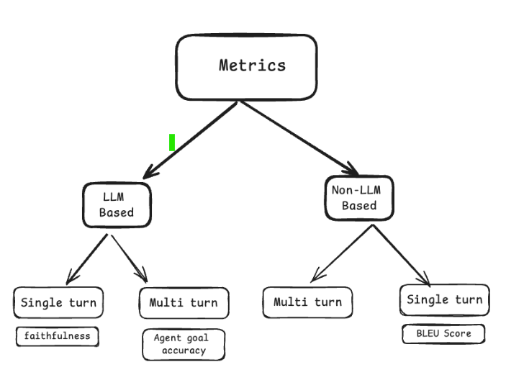
RAG Evaluation
Integrated solutions
Metrics for RAG:
Notes:
21

Slide 22
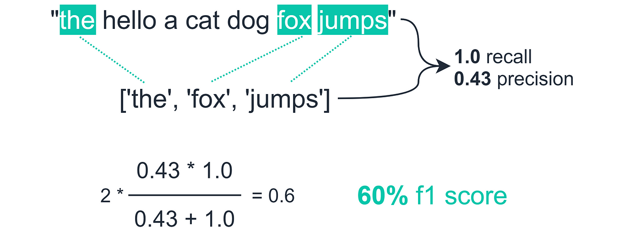
RAG Evaluation
Integrated solutions
Metrics for QA extractive (clasical)
F1 score
ROUGE score
BLEU score (several task multi lang)
GLEU score
METEOR score
Rouge-N: (P,R,F1)
Exact Match (EM)
ROUGE-N measures the number of matching n-grams between the model-generated text and a human-produced reference.
lower correlation with human evaluation
Notes:
22

Slide 23
RAG Evaluation
Integrated solutions
Metrics for QA generative (LLM based)
Correctness Evaluator: The correctness evaluator compares the generated answer to the reference ground-truth answer, given the query
Relevancy evaluator: get a measure on the relevancy of a generated answer and retrieved contexts, respectively, to a given user query from 0 to 1.
Answer relevancy measures how relevant the generated answer is to the question. This metric is computed using the question and the answer
Cosine similarity: measure the semantic similarity on the vector space (embeddings model) of answer and ground-truth
Notes:
23

Slide 24

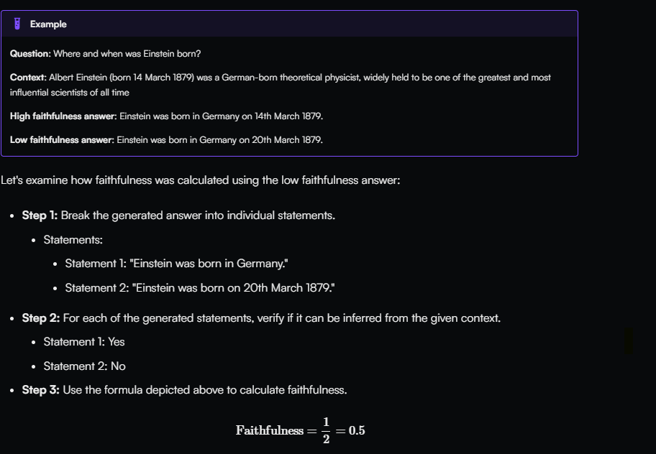
RAG Evaluation
Integrated solutions
Metrics for QA generative (LLM based)
Notes:
24

Slide 25
RAG Evaluation
Integrated solutions
Metrics for QA generative (LLM based)
To evaluate the RAG pipeline, RAGAs expects the following information:
question: The user query that is the input of the RAG pipeline. The input.
answer: The generated answer from the RAG pipeline. The output.
contexts: The contexts retrieved from the external knowledge source used to answer the question.
ground_truths: The ground truth answer to the question. This is the only human-annotated information. This information is only required for the metric context_recall (see Evaluation Metrics).
Notes:
25

Slide 26
RAG Evaluation
Integrated solutions
Test data generation
Specific vs. Abstract Queries in a RAG
Specific Query: Focuses on clear, fact-based retrieval. The goal in RAG is to retrieve highly relevant information from one or more documents that directly address the specific question.
“What year did Albert Einstein publish the theory of relativity?”
Abstract Query: Requires a broader, more interpretive response. In RAG, abstract queries challenge the retrieval system to pull from documents that contain higher-level reasoning, explanations, or opinions, rather than simple facts.
“How did Einstein’s theory change our understanding of time and space?”
Notes:
26

Slide 27
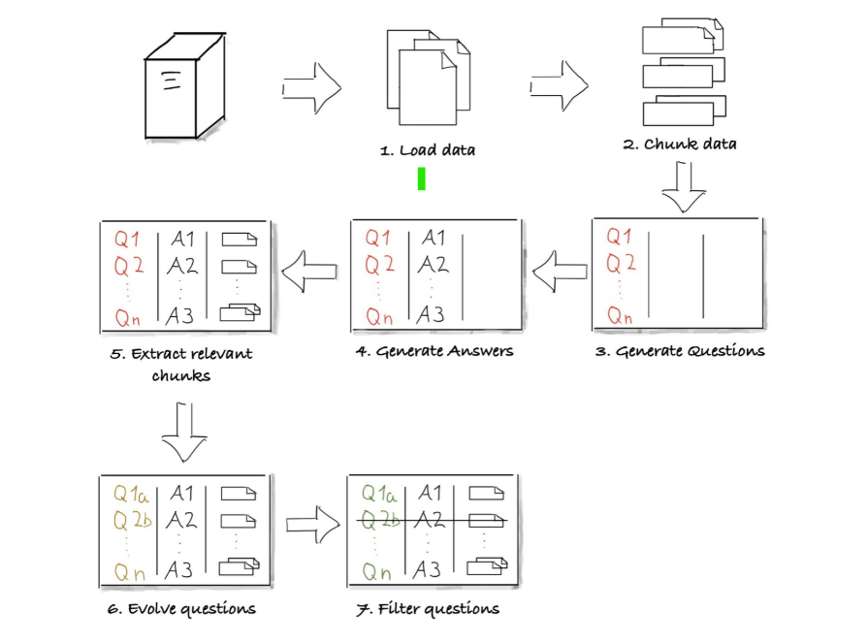
RAG Evaluation
Integrated solutions
Test data generation
Notes:
27

Slide 28
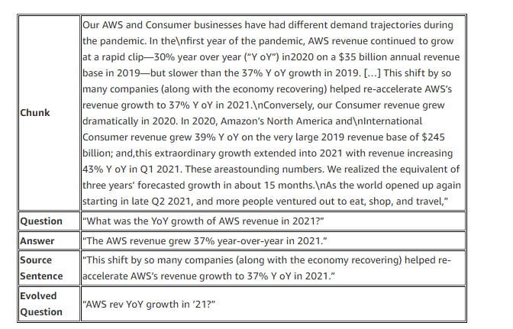
RAG Evaluation
Integrated solutions
Test data generation
Notes:
28

Slide 29
RAG Evaluation
Integrated solutions
Sources
https://hamel.dev/blog/posts/evals/ (I recommend to read this!! For testers)
https://huggingface.co/blog/os-llms
https://aws.amazon.com/what-is/retrieval-augmented-generation/?nc1=h_ls
https://learnbybuilding.ai/tutorials/rag-from-scratch
https://medium.com/@sudhiryelikar/understanding-similarity-or-semantic-search-and-vector-databases-5f9a5ba98acb
https://techcommunity.microsoft.com/blog/fasttrackforazureblog/grounding-llms/3843857
https://qdrant.tech/articles/what-is-rag-in-ai/
https://medium.com/enterprise-rag/an-introduction-to-rag-and-simple-complex-rag-9c3aa9bd017b
https://medium.com/@sandyeep70/understanding-rag-evolution-components-implementation-and-applications-ecf72b778d15
https://github.com/microsoft/generative-ai-for-beginners/blob/main/14-the-generative-ai-application-lifecycle/README.md
https://aws.amazon.com/es/blogs/machine-learning/generate-synthetic-data-for-evaluating-rag-systems-using-amazon-bedrock/
https://huggingface.co/spaces/mteb/leaderboard
https://huggingface.co/spaces/optimum/llm-perf-leaderboard
Notes:
29

